Slide 1

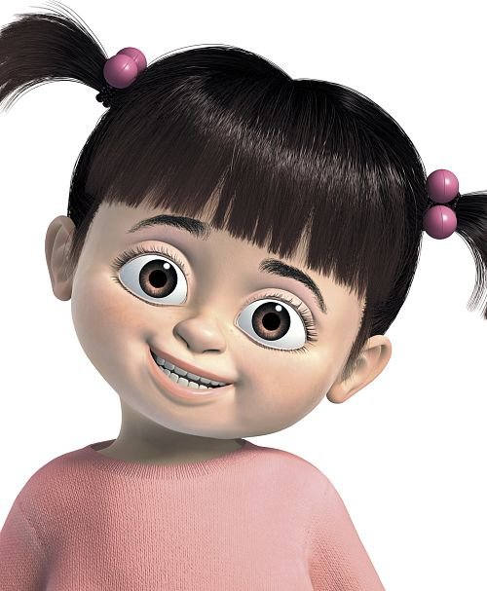
Hey,,,
Be sure to read this , it may help many of you, it even did help me.
But be sure to give it a reading, you will even enjoy and learn from it.

Slide 2
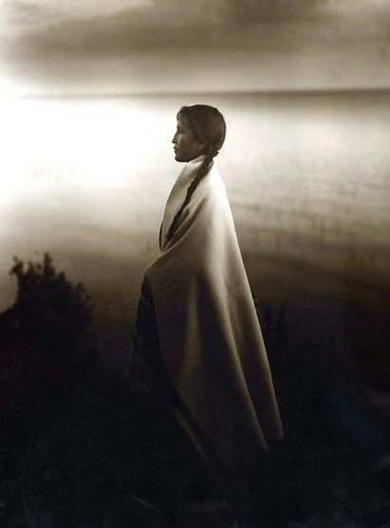
To My Friends Who Are ........... SINGLE
Love is like a butterfly.
The more you chase it, the more it eludes you.
But if you just let it fly, It will come to you when you least expect it.
Love can make you happy but often it hurts, but love is only special when you give it to someone who is really worth it.
So take your time and choose the best.

Slide 3
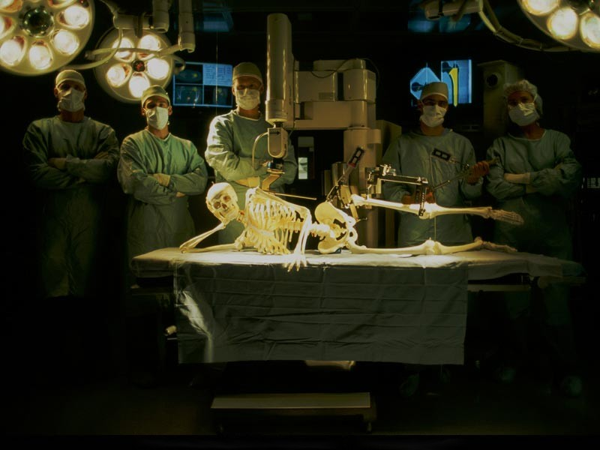
To My Friends Who Are ........... NOT SO SINGLE
Love isn't about becoming somebody else's "perfect person”
It's about finding someone who helps you
become the best person you can be.

Slide 4
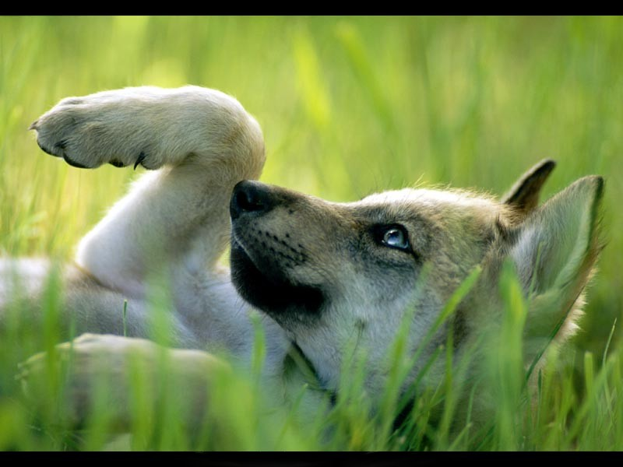
To My Friends Who Are ........... PLAYBOY /GIRL TYPE
Never say "I love you" if you don't care.
Never talk about feelings if they aren't there.
Never touch a life if you mean to break a heart.
Never look in the eye when all you do is lie.
The cruelest thing a guy can do to a girl:
Is to let her fall in love when he doesn't intend to catch her fall and it works both ways.

Slide 5
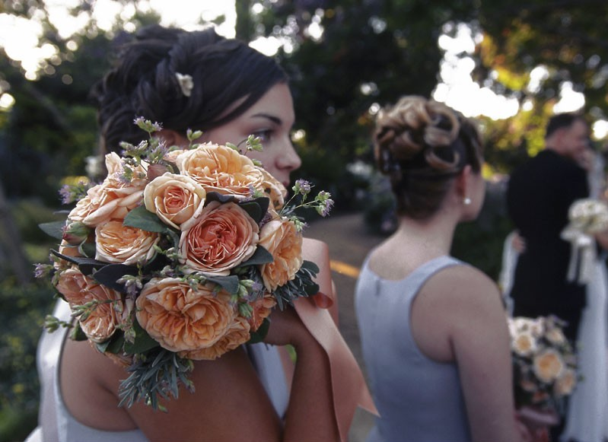
To My Friends Who Are ........... ENGAGED
The true measure of compatibility is not the years spent together
But how good you are for each other.

Slide 6
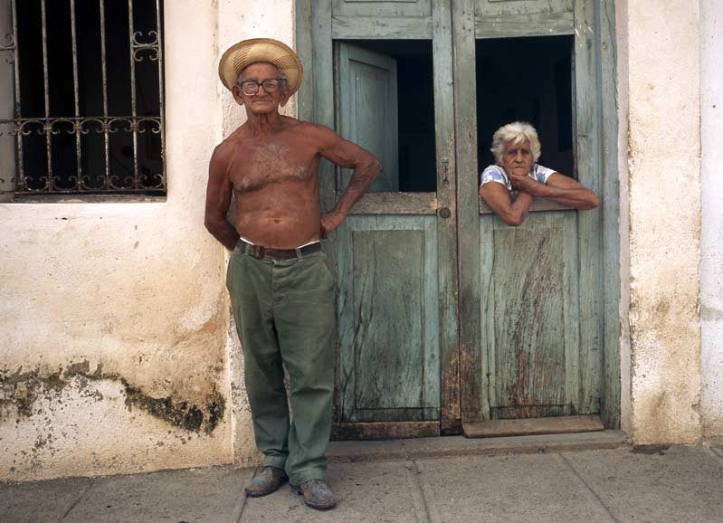
To My Friends Who Are ........... MARRIED
Love is not about "it's your fault", but "I'm sorry."
Not "where are you", but "I'm right here"
Not "how could you", but "I understand"
Not "I wish you were", but "I'm thankful you are"

Slide 7
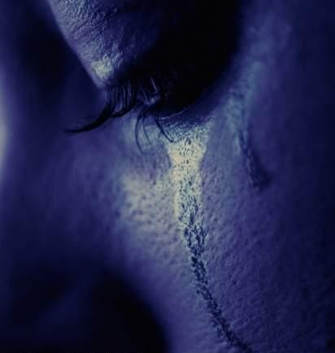
To My Friends Who Are ........... HEARTBROKEN
Heartbreaks last as long as you want
and cut as deep as you allow them to go
The challenge is not how to survive heartbreaks
But to learn from them.

Slide 8
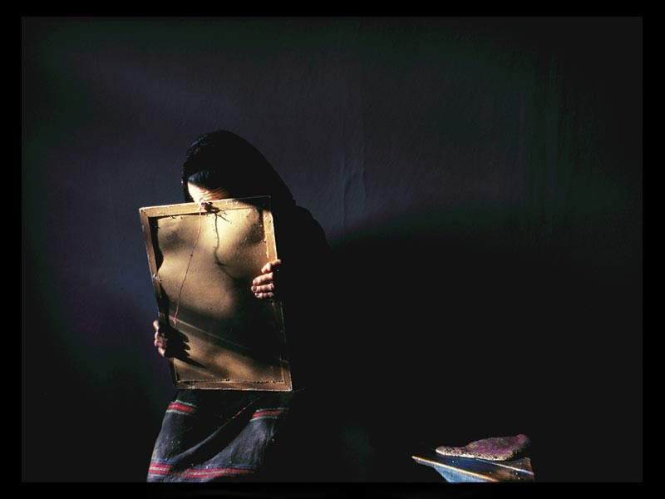
To My Friends Who Are ........... NAIVE
How to be in love:
Be consistent but not too persistent,
Share and never be unfair,
Understand and try not to demand,
And get hurt but never keep the pain.

Slide 9

To My Friends Who Are ........... POSSESSIVE
It breaks your heart to see the one you love
Happy with someone else
But it's more painful to know that the one you love
Is unhappy with you.

Slide 10

To My Friends Who Are ........... AFRAID TO CONFESS
Love hurts when you break up with someone.
It hurts even more when someone breaks up with you.
But love hurts the most:
When the person you love has no idea how you feel about him/her

Slide 11
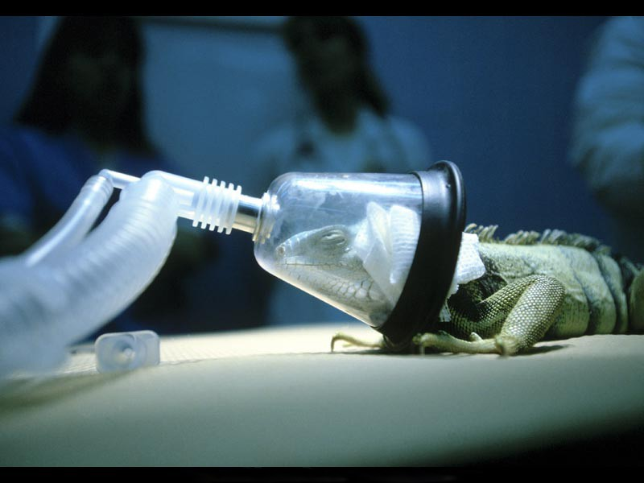
To My Friends Who Are ........... STILL HOLDING ON
A sad thing about life is when you meet someone and fall in love, only to find out in the end that it was never meant to be, and that you have wasted years on someone who wasn't worth it.
If that person doesn’t worth it now, it’s not going to be worth it a year or 10 years from now.

Slide 12
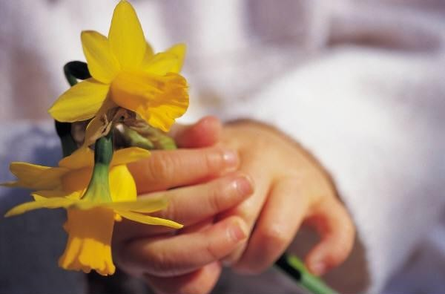
TO ALL MY FRIENDS .......
My wish for you is a man/women whose love is: honest, strong, mature, never-changing, protective, encouraging, rewarding and unselfish.
Edit by:
Othman

